Slide 1
AN INTRODUCTION TO EUROPEAN LAW
Chapter 9
Free Movement of Goods I

Slide 2

THE Internal market
The central economic task of the European Union from the beginning was the creation of a “common” or “internal” market which is defined in…
Article 26(2) TFEU: “An area without internal frontiers in which the free movement of goods, persons, services and capital is ensured.”
To create a common market the EU Treaties pursue a dual strategy:
Negative integration: Four constitutional prohibitions negating illegitimate obstacles in national laws to intra-Union trade.
Positive integration: Union is charged to adopt positive European Legislation to harmonise diverse national laws. (Article 114 TFEU)
This section will focus specifically on negative integration, and we will look at positive integration in the next section!

Slide 3

NEGATIVE INTEGRATION
What is negative integration? It is the Treaties’ “four constitutional prohibitions ‘negating’ illegitimate obstacles to intra-Union trade.” (http://www.schutze.eu/wp-content/uploads/2015/06/Introduction-Chapter-13.pdf)
All fundamental freedoms guaranteed under Article 26(2) of TFEU are clear and unconditional, subject to direct effect.
Enforcing negative integration allows the European Courts to “free” national markets from illegal barriers to trade.
The scope of positive integration is delimited by negative integration as if national laws constitute illegal trade barriers, the Union considers that there is no need to positively harmonise them.

Slide 4


1. JURISDICTIONAL SCOPE
Personal Scope; State Measures & Private Party Actions
Traditionally the court has been unwilling to extend the scope of negative integration.(See Vlaamse Reisebureus [1987] ECR 3801 paragraph 30)
However, the Court has, in the past, given a broad definition of state measures, which include:
  Central, local & regional authorities (Commission v Ireland [1988] )
  And also to the exercise of public functions by any public law body. (The Queen v Royal Pharmaceutical Society of Great Britain [1989])
Vicarious liability can still be attached to a private body acting on behalf of the state (Commisison v Ireland [1982])

Slide 5
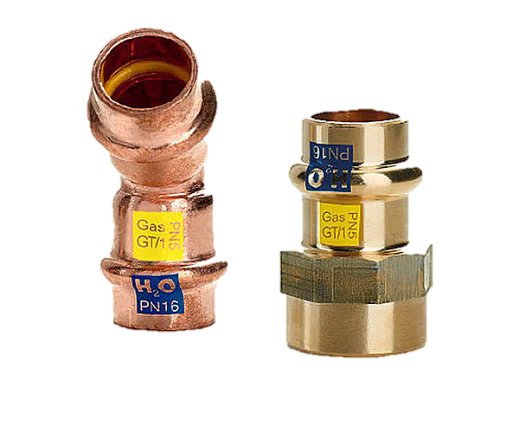
2. PERSONAL SCOPE Case C-171/11 Fra.bo [2012]
This case challenged the narrow scope of the negative integration of free movement of goods in relation to private parties.
Facts: The case concerned a German private body responsible for certifying the technical appropriateness of copper fittings.
Issue: The company refused to certify the products of Fra.bo (an Italian company) and, consequently, Fra.bo could not sell its products in Germany. Fra.bo argued that this was an infringement on its free movement rights.
Decision: The Court found that the certification body was bound by the free movement of goods provision. Hence, the refusal breached Fra.bo’s free movement rights as the certification process “in reality holds the power to regulate the entry into the German market…”
The case did not confirm the over-ruling of previous jurisprudence, however strongly suggests that the Court will acknowledge the applicability of the four freedoms to private parties in the future
Although this slide covers the basics of the case, it is recommended that the full judgment is read to fully understand the ECJ’s reasoning.

Slide 6
3. MATERIAL SCOPE
To what extent should the Union remove national trade barriers?
International Model
Each state is required to treat imported goods the same as domestic goods.
Host state control.
Federal Model
Based on the principle of home State rule.
Unitary Model
All trade restrictions not in line with a single Union standard must be removed.
Prohibition of discrimination in relation to imports.
Discriminatory effects must flow from the national measure adopted by the host.
Goods are entitled to move freely between states as long as they comply with the law of their home State.
Host State= lack of regulatory authority.
Principle of mutual recognition.
Analyses the existence of obstacles to trade in a Union frame.
If a State adopts rules tighter than the Union standard, the higher standard will violate the free movement provisions.
Discrimination test.
The European Union applies all three models above. The international model is applied for national measures, the federal model for certain regulatory trade barriers and the jurisprudence of the Court occasionally shows the unitary model.

Slide 7


CONSTITUTIONAL LIMITS
The scope of Free movement provisions must be limited as the Union is a federation of States based on the principle of enumerated powers. This is done through the de minimis test and remoteness
De Minimis Test
Minimum threshold requirement.
The Court continued to refuse to allow this test to be applied in free movement provisions. (Van de Haar [1984])
In rejecting a quantitative restriction, the court has developed a qualitative one. (Krantz [1990])
This allows the Court to scrutinise national legislation even if they have a minimal effect in the actual case but may potentially affect a broader category of traders in a serious manner.

Slide 8
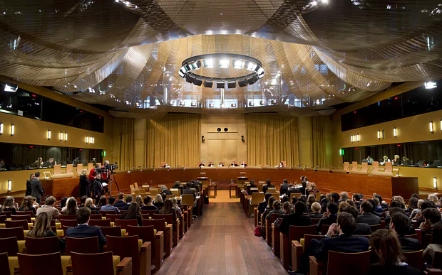
CONSTITUTIONAL LIMITS (cont.)
Purely Internal Situations?
Jurisdictional & qualitative limit conferring that the free movement provisions only applies to cross border situations.
Judicial Expression of Subsidarity
‘Subsidiarity’ means that the Union should only act in situations that have a European (or cross-border) dimension.
If there is no subsidiarity, there can potentially be reverse discrimination, which occurs when the federal model governs the scope of national integration.
Cassis de Dijon [1979]: Germany could still apply the higher consumer protection to local produce but not to the French produce.
But note that there is a wide interpretation of what constitutes cross-border movement & each case does not require this external factor either. (Pistre [1997])

Slide 9

So what barriers are dealt with under the TFEU?
Fiscal barriers
  Art 30 TFEU: Customs duties
  Art 110 TFEU
Regulatory barriers
  Art 34 TFEU: quantitative restrictions on imports. This also includes measures having equivalent effect (MEEQRs/MEEs)
  Art 35 TFEU: quantitative restrictions on exports
We will now turn to discuss each of these provisions…

Slide 10


FISCAL BARRIERS: customs duties
Definition: “A custom duty is any pecuniary charge, however small and whatever its designation and mode of application, which is imposed on goods by reason of the fact that they cross a frontier.” Commission v Italy (Statistical Levy) [1969] para 7
Article 30 TFEU outlaws customs duties within the European Union. It applies to duties and charges on imports and exports without exception. (Art 28(2) & Art 29 TFEU)
Article 30 extends to Charges having Executive Effect (CEEs). All that matters is that the charge has an effect. The slightest restricting effect will trigger Article 30. → strict application of the provision!
CEE is “any charge which, by altering the price of an article exported has the same restrictive effect on the free circulation of the article as a customs duty.” (Commission v Italy [1969])
Material scope of Article 30: outlaws national measures that impose a charge on the frontier-crossing of goods. (but this does not cover internal taxation.)

Slide 11
FISCAL BARRIERS: OBJECTIVE JUSTIFICATIONS
There are no express justifications for fiscal barriers to trade in goods.
Article 36 TFEU, which provides justifications for regulatory barriers, cannot be applied in regard of fiscal barriers. Exceptions to the free movements of goods has to be interpreted restrictively. Commission v Italy (Statistical Levy) [1969]
The Court recognised the possibility of two implied exceptions:
Consideration for Services Rendered
If the charge is beneficial to the economy as a whole as a public service rather than benefitting only the local economy. (Commission v Italy (Statistical Levy))
Compensation for Necessary Frontier Checks
The member states are acting on behalf of the EU, if that results in a cost then a charge may be appropriate for compensation. Bauhuis[1977]
Confirmed in Bresciani [1976] that a restrictive interpretation of the exception is applied. General public interests were insufficient to justify the import charge attached to the import of raw hides that needed to be checked.
Commission v Germany [1988] A charge will not be considered a CEE if a) does not exceed cost of inspection, b) the inspections are obligatory and uniform c) prescribed in EU law d) promotes the free movement of goods.

Slide 12
FISCAL BARRIERS: Article 110 TFEU
Article 110 prohibits discriminatory taxation. (Compliments Article 36)
However, it differs in material scope: Article 110 applies when foreign goods are subject to internal taxation. (deals with domestic & foreign goods.)
Article 110 is not absolute, and the prohibition only applies to taxes on goods; indirect taxes.
The Court recognised the possibility of two implied exceptions; prohibition against discrimination against Similar foreign goods & discrimination against competing goods.
Discrimination Against Similar Foreign Goods
Prevents foreign goods from being taxed in excess of similar local goods.
See Commission v France (Natural Sweet Wines) [2002] para 30
Key focus is the concept of similarity and comparability. Courts have adopted a broad interpretation of similarity.
Humblot [1985]: Mercedes car was subject to a special tax as no other car locally was produced the same. The question was: were small French cars comparable to big German ones? Yes.
Objective criteria can be used fiscally to distinguish between similar products. See Commission v France (Natural Sweet Wines) [1987] para 9-10
Discrimination against Competing Foreign Goods
  Article 110(2) TFEU is an extension of the discrimination rationale in Article 110(1).
  Outlaws internal taxes that grant indirect protection to domestic goods
  Two elements to be fulfilled;
    The national tax will tax competing goods differently
    This differentiation will indirectly protect national goods.
  Commission vs. UK (Beer and Wine) [1980]

Slide 13

Regulatory barriers
Restrictions
Chapter 3 of Title II TFEU provides the basis of the regulatory barriers regime.
Quantitative restrictions on imports (Article 34) and exports (Article 35)
Article 34: restrictions on quantity of imported goods. (Geddo [1973])
Import quotas operate as absolute frontier barriers; once a quota for a product is exhausted, foreign imports cannot enter the domestic market.
Article 34 covers another form of measure; Measure having an Equivalent Effect to Quantitative Restrictions. (MEEQRs)

Slide 14
MEEQR: DASSONVILLE & TRADING RULES
Facts:
  Belgian law required Scotch whisky to have a certificate of origin in order to be sold
  Dassonville purchased Scotch whisky in France, to sell on in Belgium
  He forged certificates of origin in order to satisfy Belgian law
Issue in law:
  Was the Belgian law incompatible with EU law;
  and more specifically art 34 TFEU, which prohibits quantitative restrictions on imports and all measures having equivalent effect between Member States?
Decision: The Belgian Law was incompatible.
Reasoning:
  The Court of Justice defined a ‘measure having equivalent effect’ as:
  “All trading rules enacted by Member States which are capable of hindering, directly or indirectly, actually or potentially, intra-Community trade are to be considered as measures having an effect equivalent to quantitative restrictions.”
  As it would be more difficult for a seller such as Dassonville to sell Scotch Whisky in Belgium than in France (he would have to adapt his whisky at additional cost in order to sell it in Belgium), the Belgian law was a measure of equivalent effect and must be prohibited.

Slide 15
MEEQR: CASSIS de dijon & product requirements
Facts:
A German liquor importer was refused permission to import ‘cassis de dijon’ liquor into Germany from France, as ‘Cassis de Dijon’ would violate German law requiring fruit liquors to contain a minimum alcohol volume of 25%
Issue: Did this refusal breach Art 34 TFEU?
Decision: Yes, the refusal constituted a breach of Art 34 TFEU.
Reasoning:
Art 34 TFEU provides that: “Quantitative restrictions on imports and all measures having equivalent effect shall be prohibited between Member States.”
The Court of Justice found that under the principle of mutual recognition, a product lawfully marketable in one Member State (France) should be freely marketable in another Member State (Germany).
The Court of Justice found that such a measure could no longer be justified only under Article 36 TFEU.
However, the Court of Justice introduced the concept of ‘overriding reasons of public interest’ (ORPIs) – grounds of justification to act in addition to the Art 36 grounds. The court introduced several in this case: “1) necessary in order to satisfy mandatory requirements relating in particular to the effectiveness of fiscal supervision, 2) the protection of public health, 3) the fairness of commercial transactions and 4) the defence of the consumer.”
ORPIs may only be used where Art 34 measures have a non-discriminatory effect, equally applying to both domestic and foreign products.

Slide 16
Meeqr: Keck & CERTAIN selling arrangements
Facts:
Keck was prosecuted for selling products under wholesale values which contravened Article 34 TFEU.
The French competition law at issue prohibited retail of products below wholesale price to prevent cut throat competition by putting excess produce into the market.
Issue: Did the French law discourage imports making the law a MEEQR because importers are often new entrants to the market, and while trying to acquire market share and brand recognition they may wish to cut prices?
Decision: The French law was compatible with Article 34 TFEU.
Reasoning:
The Court of Justice held that he purpose of the French law was not to regulate trade.
If a rule applies to all traders in the same manner, and affects them in the same way in law and in fact, it is lawful if it is merely a selling arrangement.
The Keck decision drew a line between what it said were "product rules", i.e. those relating to designation, form, size, weight, composition, presentation, labelling, packaging – which would be prohibited under article 34 TFEU, and "selling arrangements" which were considered not to be caught by the ambit of the article.

Slide 17
Meeqr: Italian trailers & consumer restrictions
Facts: An Italian rule prohibited motorcycles, mopeds, bicycles etc. from pulling trailers and thus there was effectively a ban on a certain type of trailer.
Issue: Was this rule discriminatory and a MEEQR under Article 34 TFEU?
Decision:
The ECJ found that the rule did not discriminate with regard to origin but in fact only imports were affected as no trailers were manufactured in Italy.
Prohibition deemed to have an impact on consumer behaviour which will have an affect on the product demand this made it an MEEQR.
Deemed that this could be justifiable, however, under the mandatory requirement of road safety.
Reasoning:
The ECJ identified three situations where a rule could be regarded a MEQR.
  1. Where the object/effect of the measure is to treat products from other member states less favourably than domestic products.
  2. When a measure requires goods lawfully made in another member state to meet another condition even if it applies to all products indiscriminately.
  3. Any other measure which hinders the access of products originating in other member states to the market.

Slide 18
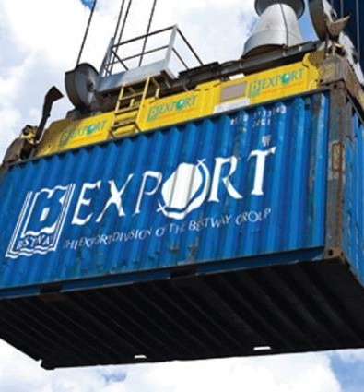
Article 35 TFEU
Article 35 mirrors the wording of Article 34 but concerns exports.
Scope of Article 35 is indirectly limited by the scope of Article 34 also.
The principle of mutual recognition as established in Cassis was extended to apply to Article 35 in Groenveld [1979]
Equally applicable product requirements would not constitute MEEQRs on exports.
Gysbrecht [2008] established the test applied to Article 35 which stated that an MEEQR will be deemed to exist if, “its actual effect is none the less greater on goods leaving the market of the exporting Member State than on the marketing of goods in the domestic market of the Member State.”
Article 35 is also based on a discrimination test.

Slide 19


Regulatory barriers: justifications
Article 36 allows for justifications to be made regarding restrictions or MEEQRs.
There are 6 grounds of justification:
Public morality (Regina [1979])
Public policy (Thompson, Johnson & Woodiwiss [1978])
Public security (Campus Oil [1984])
Protection of health & environment (Peijper [1975])
National treasures
Intellectual property rights (Van Zuylen freres [1974])
This list is exhaustive (Commission vs. Ireland [1981])
Article 36 is interpreted strictly. (Bauhuis [1977])
Implied derogations are allowed in relation to Article 36 also due to Cassis de Dijon in relation to non-discriminatory measures.

Slide 20

Proportionality of national standards
Any restrictions established by a national measure needs to be proportionate. (Sandoz [1983])
The restriction needs to be necessary. (De Smedt [1982])
There is room for discrepancies between states in regards as to what constitutes “necessity,” and high national standards are allowed as can be seen in Henn & Darby [1979].
Whether or not a national standard will be deemed to be proportionate will depend on discriminatory considerations as well as national values.

Slide 21

Consumer protection & European standards
National restrictions can be justified on the grounds that
“suitable information is conveyed to the consumer.” (Cassis de Dijon)
Consumer protection is one of the most prominent imperative requirements for the free movement of goods.
Commission vs. Germany (Beer Purity) [1987] made it clear that a high national consumer standard must never, “crystallize given consumer habits so as to consolidate an advantage acquired by national industries concerned to comply with them.”
Mars [1995] further developed the “European” consumer standard.
Estee Lauder [2000] established that the Court will allow for a higher national consumer standard where social or linguistic factors make a group particularly vulnerable.
In these situations the restriction to free movement of goods can only be removed via positive integration.
This Photo by Unknown Author is licensed under CC BY-NC-ND

Slide 22
Intellectual property justifications
This justification comes under Article 36 TFEU.
IP rights tend to come in two forms: patents and trademarks.
Tension between private property rights and the internal market created by IP rights, as the exclusivity of the rights pose as a hinderance to the development of the internal market.
Specific Subject Matter Doctrine
IP rights can be limited by EU Law.
There is a difference between existence and exercise of IP rights via Article 345 TFEU.
The use of IP rights under Article 36 will only be justified when they concern specific subject matter.
Centrafarm v Sterling Drug [1974])
Separate definitions for patents and trademarks.
Exhaustion of Rights Doctrine
Question of Union exhaustion; exhaustion will take place for the entire Union market following exhaustion of exclusive IP right.
Centrafarm vs. Sterling Drug [1978] see para 10-11
Patent holders cannot use their property rights to block imports that they placed on the market of the exporting state.
Key characteristic is consensual marketing.

Slide 23

conclusion
We have reviewed the scope and nature of the EU’s negative integration complex.
Free movement is evidently difficult and still developing.
Constitutional regime governing free movement of goods is more difficult than the other freedoms, as sovereignty and uniformity both conflict when considering trade.
Margin of discretion in regards to justifiable restrictions also varies depending on the type of justification.
Judicial case law negatively harmonises national laws.
We will now turn to positive harmonisation, which complements this process

