Slide 1
AN INTRODUCTION TO EUROPEAN LAW
Chapter 12
Competition Law: Cartels

Slide 2
COMPETITION MARKETS & CARTELS
Competitive markets are one which economic rivalry enhances efficiency.
EU competition law initially conceived to complement the internal market.
Chapter 1 of Title VII TFEU
Private undertakings/public interferences.
The section on private undertakings is built on three pillars.
    Anti-Competitive Cartels → Article 101
    Market Abuse by Dominant Power → Article 102
    Control of Mergers and EU Merger Regulation
Article 101
Article 102
EU Protection against Anti-Competition
EU Mergers Regulation

Slide 3

PILLAR 1: ARTICLE 101
Outlaws anti-competitive collusions (also known as cartels)
Article 101 follows a tripartite structure;
Prohibits undertakings that are anti-competitive by object or effect if
they affect trade between member states.
2. Establishes that illegal collusive practices are automatically void.
3. Provides for justifications of certain collusions.
ARTICLE 101(1)
An undertaking according to Hofner & Elserv [1991] for the purposes of EU competition law is “every entity engaged in an economic activity, regardless of the legal status of the entity & the way in which it is financed.” (broad, functional definition)
Economic activities are “any activity consisting in offering goods or services on a given market.” (Pavlov [2000])
This excludes consumers from Article 101. (FENIN [2003])
Public functions are not undertakings. (Poucet & Pistre [1993])
Public Authorities engages in an economic activity? (See Bodson [1988])

Slide 4
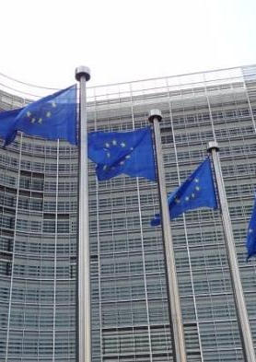
THE SINGLE ECONOMIC UNIT DOCTRINE (ARTICLE 101(1))
Article 101 covers collusions between undertakings.
Prohibited act under the Article must be bilateral or multilateral.
Article 101 prohibition does not apply in an internal undertaking. (Becu & others [1999])
Single economic unit doctrine covers relationships involving workers and legally independent undertakings in corporate groups. (Centrafarm & de Peijper [1974])
Key element of the single economic unit doctrine is control.
If there is an evident relationship of control being held over the other in general, Article 101 will not apply to any undertakings.

Slide 5
Forms of collusion
Three forms of collusion are covered explicitly by Article 101: agreements between undertakings, decisions by associations of undertakings & concerted practices.
The final form is to catch institutionalised cartels and to avoid a loophole that would allow the establishment of an association to adopt unilateral decisions on behalf of the undertakings.
Horizontal & Vertical Agreements
Concerted Practices & Parallel Conduct
Agreements (potential) effect on trade
  Agreements are “a concurrence of wills” between economic operators. (Bayer AG [2000])
  Horizontal agreements; between competing undertakings.
  Vertical agreements; undertakings are at different levels on the commercial chain.
  Both forms of agreement are subject to the jurisdiction of EU competition law. (Consten & Grundig v. Commission [1964])
  Concerted practices are those that fall short of an agreement.
  Coordination between undertakings (not necessarily consensual.)
  Is wider and vaguer than agreements; concerns behavior rather than a contract.
  Strategic behavior.
  Collective price raising etc can be deemed to be a concerted practice as it is parallel conduct. (Imperial Chemical Industries [1972])
  Not all parallel behavior is concerted practice.
  Difficult to draw a line between illegal concerted practice and legal parallel conduct.
  Jurisdictional scope of Article 101 only concerns agreements that may affect trade between Member States.
  Principle of subsidiarity applicable here. (Consten & Grundig [1964])
  Agreements must have an inter-State dimension.
  For Article 101 to apply the pattern of trade test needs to be met. (Societe Technique Miniere [1965])
  What is important is the potential effect.
  Delimitis [1991] established the contextual approach the Courts apply in examining whether an agreement fits into a broader network of similar contracts.
  Non-Appreciably-Affecting-Trade Rule.
  Cumulative effect considered.

Slide 6

TACIT ACQUIESCENCE VS UNILATERAL CONDUCT
Every agreement requires common consent between the parties.
If a party unilaterally imposes its will on another this is not an agreement.
Unilateral behaviour can exhibit an agreement as it can form part of the contractual relations between the undertaking and its dealers. (Ford v. Commission [1985])
Beyer v. Commission [2000] For an unilateral act to constitute an agreement there needs to existence acquiescence by the other parties in the attitude adopted.
For a unilateral act to be an agreement there needs to be tacit acquiescence.

Slide 7
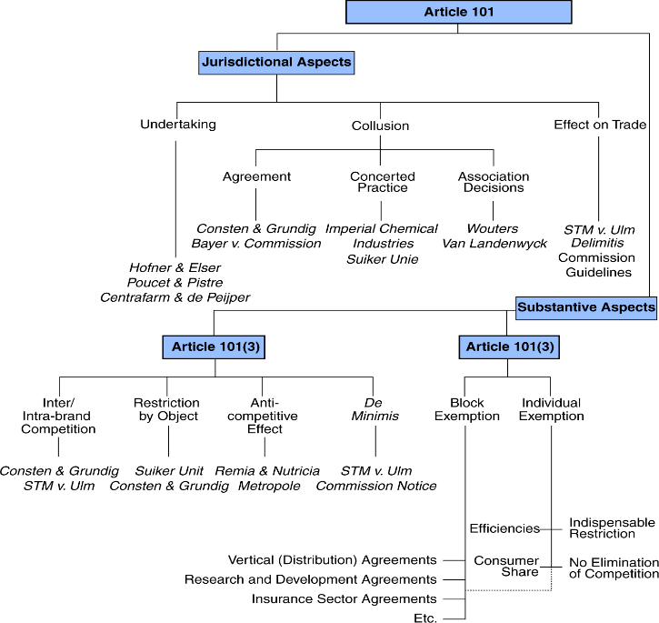
ARTICLE 101: RECAP
There are three pillars of EU competition law.
Pillar 1= Article 101 TFEU
What is an undertaking?
Single economic unit doctrine.
How much of an effect does this undertaking need to have on a market for its actions to be within the scope of Article 101 TFEU?
Three forms of agreement.
What actions are restricted?
What justifications are there?

Slide 8
Restrictions of competition
To violate Article 101(1) an agreement must prevent, distort or restrict competition.
Restriction of competition refers to the protection of the structural freedom offered by the market to all actual all potential competitors according to the European Court.
The EU recognises both inter-brand and intra-brand competition.
Consten & Grundig [1964] establishes that restrictions to vertical agreements (intra-brand) would still violate Article 101(1)
Holistic approach applied by the court (Societe Technique Miniere) in regards of non every restriction of intra-brand competition will be a breach of Article 101.

Slide 9
Restrictions of competition (cont.)
Restriction by Object
Restriction by Effect
  To identify certain “hard-core” restrictions within an agreement.;
  Per se rules: rules whose existence constitute a breach of competition law.
  Price fixing clauses, output limiting clauses, market share clauses (horizontal agreements.) Fixed (minimum) resale price and absolute territorial protection clauses are vertical restrictions by object.
  Consten & Grundig; exclusive distribution at a relative level is an agreement that had at its object the restriction of competition.
  If there are no clauses that are per se restrictions of competition, there needs to be proof of the agreements anti-competitive effect.
  Absolute test or relative test?
  No rule of reason under Article 101(1) (Metropole Television [2001])
  Doctrine of ancillary restraint applied by the court.
  Abstract doctrine that tolerates contractual clauses without which the main agreement is not possible to implement. Only objective restrictions are allowed; the rest will be deemed to be a restriction as per Article 101(1)

Slide 10
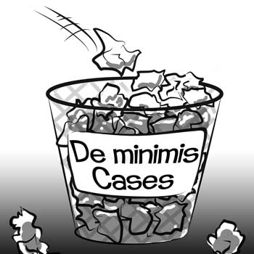
NON-APPRECIABLE RESTRICTIONS
De minimis non curat lex; the law does not concern itself with trifles.
Article 101 is not to create perfect competition market; only workable.
De minimis rule applied to Article 101 meaning restrictions of competition will only fall within the Article if they do so to an appreciable extent. (Societe Technique Miniere)
See the Commission’s De Minimis Notice [2001]to understand the relevant market share measurement.

Slide 11
ARTICLE 101(3): EXEMPTIONS & JUSTIFICATIONS
If an agreement is anti-competitive (Article 101(1)), it will be void (Article 101(2)) unless justified in accordance with Article 101(3).
Article 101(3) contains all elements of a rule of reason.
It is via Article 101(3) the anti-competitive and the pro-competitive effects of an agreement will be considered. (Metropole Television)
Applies to all agreements & has direct effect.
DIRECT EXEMPTIONS
An exemption is conditional on two positive and two negative criteria.
If an agreement generates productive or dynamic efficiencies these may outweigh the anti-competitive aspects of the agreement. (positive)
Efficiency defence is broad.
Consumers need to get a fair share in the resulting benefit.
If the agreement is dispensable for the pro-competitive effects of the agreement or it eliminates competition in respect of a substantial part the agreement will not be exempt. (negative)
For a restriction to be indispensable it needs to be necessary to achieve efficiency and these efficiencies are specific to the agreement in question.

Slide 12
BLOCK EXEMPTION REGULATIONS
Horizontal Cooperation Agreements
Vertical Distribution Agreements
  Can be seen as potentially pro-competitive.
  Research and Development Agreements: can potentially restrict competition but can be justified.
  Commission has developed a specific Block Exemption where the market share between competing undertakings does not exceed 25% of the relevant market.
  Agreements between producers and distributors.
  Agreements concluded between non-competitors
  Exclusive distribution agreements; question of territorial exclusivity and extension of parallel traders.
  Absolute territorial protection is objectively a restriction on trade but relative protection can be allowed if they do not impose a direct/indirect ban on export upon the distributor.
  Selective distribution limit distribution to selected distributors.
  Metro v Saba [1977] established the Metro doctrine that sets out the criteria required for selective distribution to not violate Article 101.
  Vertical Block Exemption Regulation [2010] Exempts all vertical agreements provided that neither producer nor distributor enjoys more than a 30% market share.
  Article 4 covers hardcore restrictions that will block the whole agreement from being exempt.
  Article 5 covers excluded restrictions that only deny the specific clause from being individually exempted.

Slide 13
DOMINANT UNDERTAKINGS;
MARKET ABUSE
Article 102 focusses on the bad behaviour of a single undertaking.
Sanctions unilateral behaviour that amounts to market abuse.
The prohibition only applies if the abusive behaviour may affect trade between Member States.
To violate Article 102 three criteria need to be met:
  Market
  Dominance
  Abuse

Slide 14
DOMINANT UNDERTAKINGS:
MARKET ABUSE (cont.)
The higher the market share the higher the likelihood of market dominance. (Hoffmann- La Roche [1979])
Structural dominance also exists allowing relative dominance as well as absolute dominance.
Collective dominance via an oligopoly can have the same consequences as a single dominant undertaking.
Vetro et al v. Commission [1992] established it was possible for collective dominance to exist in breach of Article 102 but it is required that there is an economic link between each firm.
CEWAL [2000] and Piau [2005] clarified the criteria for finding collective dominance.
Geographic & product dimensions of markets.
Product market concerns the interchangeability of two products (Hoffmann- La Roche [1979]) and the cross-price elasticity of two products.
If two products are competing they must be offered in the same geographical market (United Brands [1978])
The geographical market identified must represent a substantial part of the internal market.
MARKET
DOMINANCE
ABUSE

Slide 15
MARKET
DOMINANCE
ABUSE
What constitutes an abuse depends on the context of the behaviour; is it the behaviour of a dominant undertaking.
Behaviours listed in Article 102 are not illegal per se; only illegal if conducted by a dominant undertaking.
Article 102 covers exploitative & exclusionary behaviours.
An abuse is not limited to the market in which the dominant undertaking is within; Article 102 can extend to adjacent markets but in accordance with Tetra Pak [1996] there needs to be a link and this can only be done in special circumstances.
Article 102(2)(a); Predatory Pricing
Includes excessive pricing (consumer exploited) and predatory pricing (to exclude a competitor)
Excessive pricing is hard to establish.
Predatory pricing is subject to the detector test established in AKZO [1991] which establishes the presumption that if the price of the product was below average variable costs the pricing policy would be abusive per se. If average it can still be abusive if it can be shown to be part of a strategy to eliminate a competitor.

Slide 16

Article 102 (2)(b) Refusal to Supply
Limiting production or technical development to the prejudice of consumers.
Dominant undertaking in a market has special responsibilities if there are no alternative supply. (freedom of contract cannot be granted if this is the case.)
Commercial Solvents [1974] established that the refusal to supply to certain parties to facilitate own access to the market was an abuse under Article 102. (Confirmed in Magill [1995])
Is limited; cannot be used to demand access to a competitors distributive infrastructure. (Bronner [1998])
Article 102 (2)(c) Discretionary Pricing
Price discrimination (indirect or direct) can occur via conditional discounts or rebates.
There exists legitimate rebates or discounts as well as illegitimate. (See Hoffmann La-Roche)
Difference between quantity discounts and loyalty discounts (Quantity legal/ loyalty illegal as seen in Michelin I & II)
Modern effects based test used
Article 102(2)(d) Tying or Bundling
Adding extra obligations to the conclusion of a contract of acceptance.
Tetra Pak II [1994] demonstrates how this can occur when the sale of one product is tied to another which can be a market abuse if the tying is not in line with commercial usage.
Microsoft, tied customers by giving them no choice but to obtain the product. The case established four elements; no choice, conclusion of contract is subject to acceptance of supplementary obligations, did this foreclose competition for the bundled product and was there any objective justification?

Slide 17


Objective justifications
Unwritten objective justifications available to Article 102.
Behaviour of the dominant undertaking can be considered non-abusive due to a special context.
This must be beyond the control of the dominant undertaking and which it cannot overcome by any means other than by adopting the conduct which appears abusive.
The efficiency defence is also evident in relation to Article 102.
British Airways [2007] is evidence that an exclusion can be counterbalanced by efficiency advantages which benefit the consumer also.
This is controversial but Microsoft, clarifies its existence as an objective justification to Article 102.
Questionable legal parameters of the efficiency defence however.

Slide 18
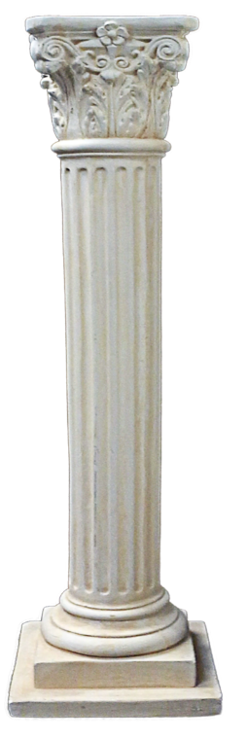
PILLAR 3: Eu merger control
Third pillar of EU Competition Law.
Merger control aims to prevent the creation of market structures whose concentration intensity would facilitate anti-competitive conduct (ex ante approach.)
EU MERGER REGULATION (139/2004)
Article 3 defines what a merger is. (3 types)
Only applies to mergers that have a European dimension (jurisdictional scope, Article 1)
Only outlaws mergers that significantly impede effective competition. (substantive scope, Article 1)
Stemmed from the application of Article 101 & 102 to mergers (as seen in cases such as British American Tobacco [1987] and Continental Can [1973])
The regulation represents the central control mechanism for mergers in the EU and targets significant structural changes that impacts on the market beyond Member State borders.

Slide 19

SUBSTANTIVE COMPATABILITY
Mergers are subjected to a compatibility test in order to establish whether the merger significantly impedes effective competition. (SIEC Test, Article 2(3))
SIEC test replaces the old dominance test under the old Merger Regulation.
SIEC test can be applied to mergers that create oligopolistic situations in which there is no collective dominance.
Commission has wider discretion to scrutinise the economic effect of mergers. This discretion is subject to the Commission Guidelines however.
Commission appraisals will be struck down by the Court however if the Union executive did not convincingly prove that the merger violated the regulation.(Airtours v. Commission [2002])

Slide 20
MERGER DEFENCES & DEROGATIONS
Article 2 directs the Commission to consider relevant interests and advantages to consumers when examining whether a merger will be an obstacle to competition.
The Horizontal Merger Guidelines explicitly refers to the existence of an efficiency defence.
For this defence to apply the consumer benefits need to be substantial, merger specific and verifiable.
Failing firm defence is also acknowledged in the Guidelines. This covers rescue mergers. These rescue mergers do not fulfil the SIEC test as a change to the market structure would have occurred anyway.
DEROGATIONS; The Public Policy Justification
Article 21(4) provides Member States the possibility of assessing mergers that can affect their legitimate interests.
Member States can object to a merger within their territory.
The final decision will rest with the Court of Justice and the Courts will decide upon the proportionality of the national interest that is invoked by the Member State. (Portugal v. Commission [2004])

Slide 21

CONCLUSION
EU Competition law is a cornerstone within the Union’s internal policies.
Aim is to create a workable market rather than a perfect market.
Based on three pillars; Article 101, Article 102 TFEU and the EU Merger Regulation.
Some Anti-Competition measures can be justified.
Article 101 & 102 seek to end violations whereas the Merger regulation seeks to prevent violations.

